Slide 1

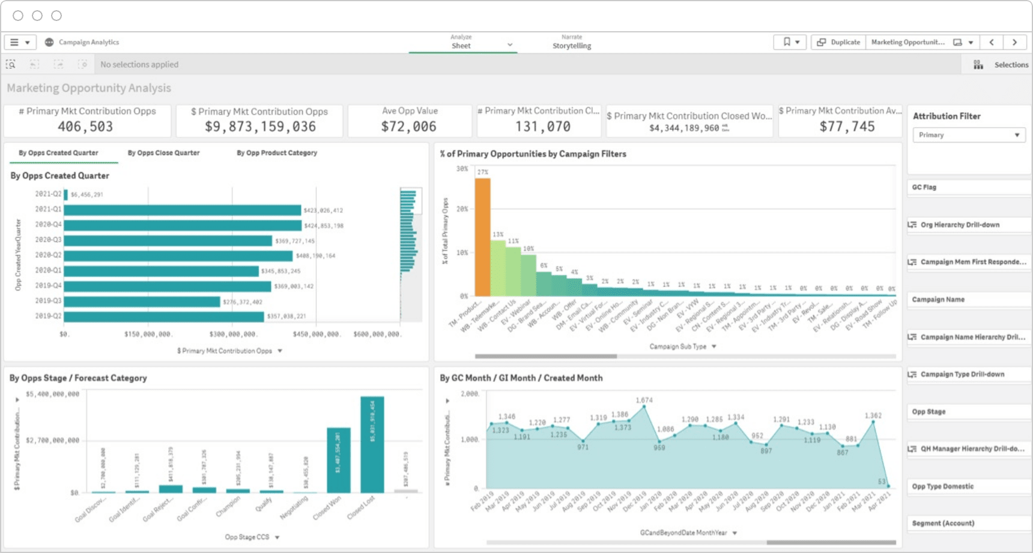

Unlocking Marketing Insights: Strategies for Success
Task, Analysis, &
Solution Proposal
Emma Ramey, Isael Corona,, Karen Dominguez, & Nicole Pastor
COOP Data Analytics 2024 C441

Slide 2
The Team- SPF 400
Spatial Analyst- Karen Dominguez
Inventory Analyst- Isael Corona
Creative Analyst- Emma Ramey
Audience Analyst- Nicole Pastor

Slide 3
Outline
Task
Location Strategy
Inventory & Viewability
Creative Strategy
Audience
Recommendations

Slide 4
Task
Maximize the marketing agencies future strategies by analyzing reporting for Location, Audience, Creative and Inventory Insights

Slide 5

Cost Efficiency, Devices Popularity, & Locations
2. Inventory Sources & Publishers
Agenda
3. Creative Strategy
4. Audiences

Slide 6
Market Efficiency
Identify the top and bottom 10 performing Designated Market Areas (DMAs)
Identify markets to exclude from future initiatives
Devices & Locations
Identify top and bottom 10 performing devices across top and bottom DMAs
Identify which devices were the most cost effective in top and bottom DMAs
Device Types & Operating Systems
Identify the top 5 publishers (websites) whom our clients should Direct Buy from based on KPI’s
Identify the top inventory sources (exchanges) yield the greatest results by their KPI’s
Goals
Creative Sizes
Identify which creative sizes are the highest and lowest performers
Performance metrics
Branding Metrics
Highest and lowest performers by
Device
Location
Messaging
Audience
Identify the top 10 performing audiences
Performance Metrics
Branding Metrics
Create insights from findings
Segment audiences into groups based on factors & characteristics
Notes:
Device Types & Operating Systems
Why these devices are performing or underperforming?
Are there devices your client should exclude from future initiatives? Why?

Slide 7
Location Influence on Performance
Karen Dominguez- Spatial Analyst

Slide 8
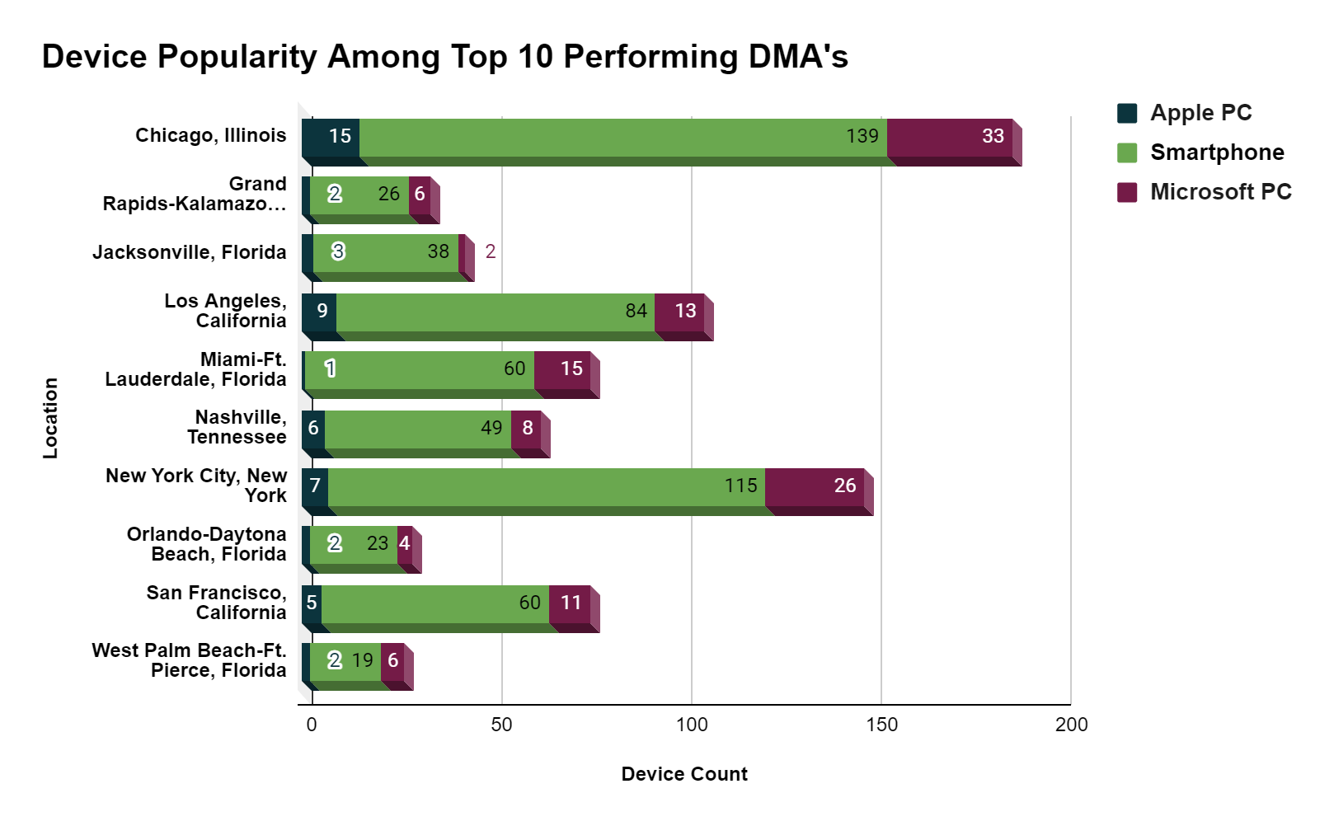
Device Popularity Among Top and Low Performing DMA’s
Across top 10 DMA’s
Device’s Ranked in Top Popularity DMA’s
1. Smartphones
2. Microsoft PC
3. Apple PC
Top Devices in Bottom DMA’s: Smartphones, Window PC, and Apple PC
Apple PC was the least popular device across both Top and Bottom DMA’s while smartphones was the most popular

Slide 9
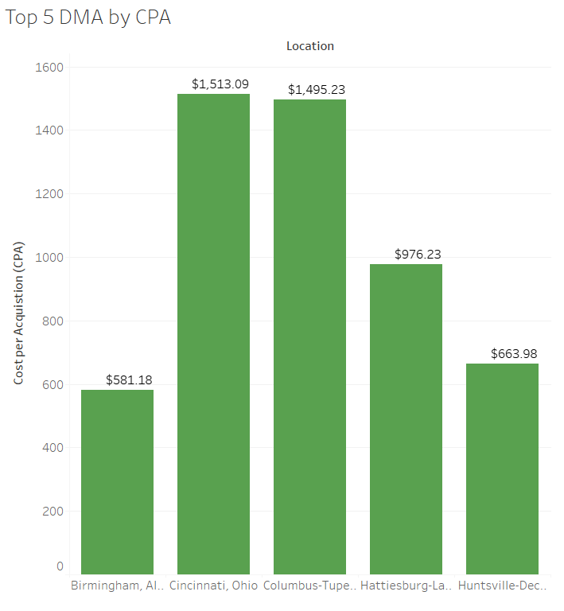
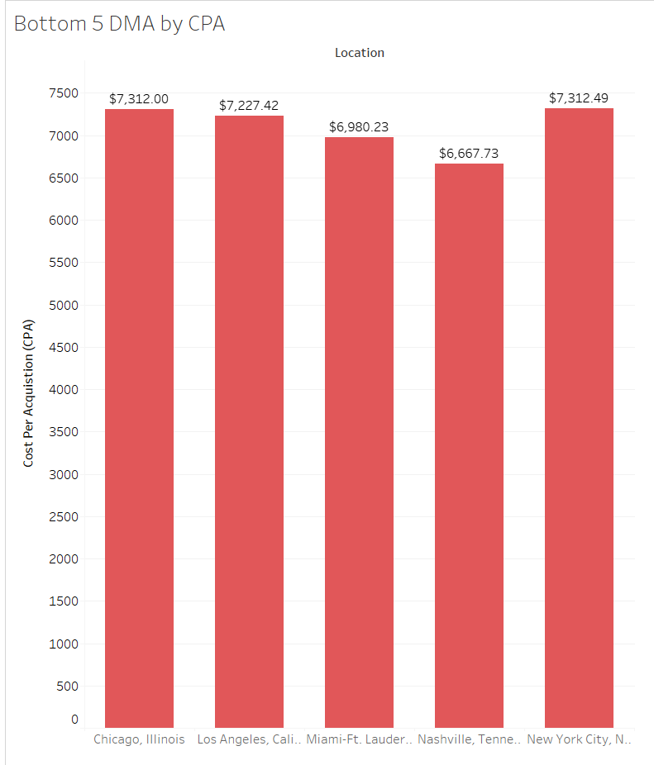
Designated Market Area by Cost per Acquisition (CPA)
Highest Performers:
Birmingham, AL:
$ 581.18
Huntsville-Decatur( Florence) Alabama:
$663.98
Hattiesburg-Laurel, Mississippi:
$ 976.23
Columbus-Tupelo-West Point, Ohio:
$1,495.23
Cincinnati, Ohio:
$1,513.09
Lowest Performing:
New York City, NY
$ 7,312.49
Chicago, IL
$7,312.00
Los Angeles, CA
$7,227.42
Miami-Ft. Lauderdale, FL
$ 6,980.23
Nashville, TN
$ 6,667.73

Slide 10
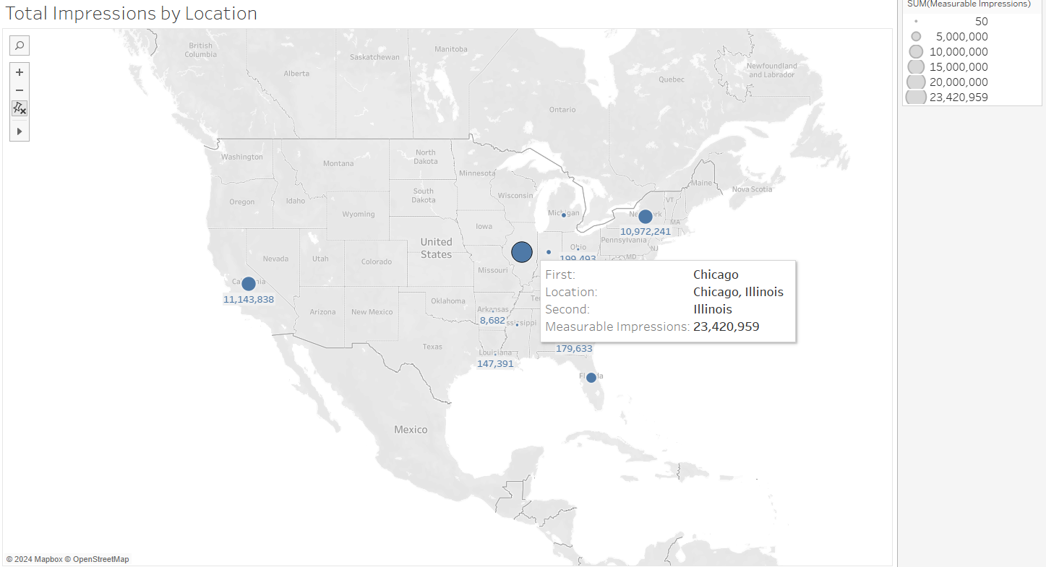
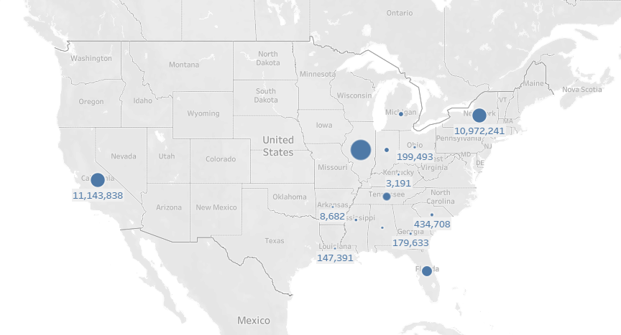
Measurable Impressions by Location
Highest Impressions: Chicago, IL: 23,420,959
Los Angeles, CA:
11,143,838
New York City:
10,972,241
Recommendation: Urban and metropolitan markets produce higher measurable impressions, therefore making these markets profitable( best value for money spent)

Slide 11
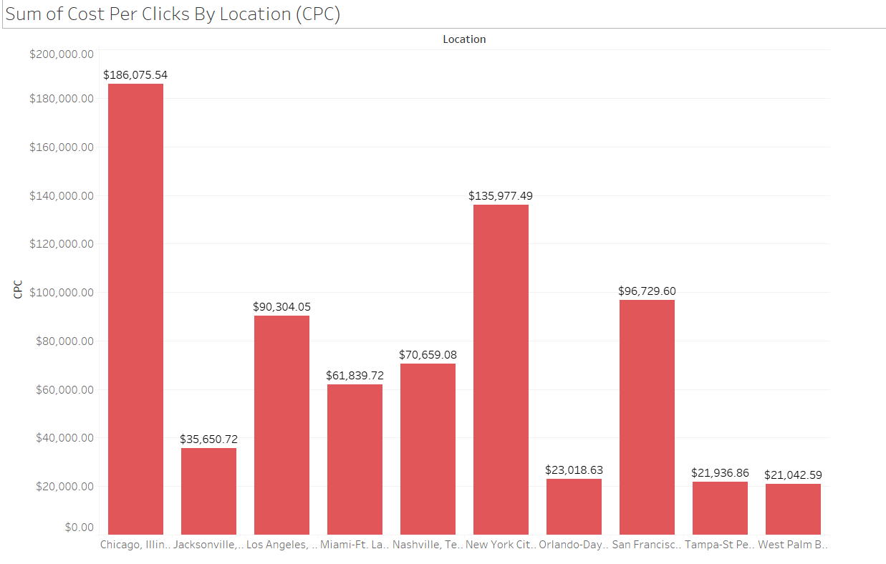
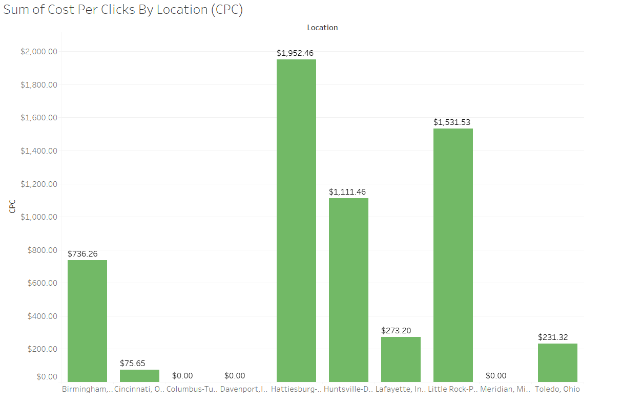
Sum of Cost Per Clicks by Location (Top & Bottom 10)
Lowest Performing CPC- Chicago, IL
Highest Performing CPC- Columbus, Tupelo West Point, Mississippi, Davenport-Iowa-Rock Island Moline, lL, Meridian Mississippi

Slide 12
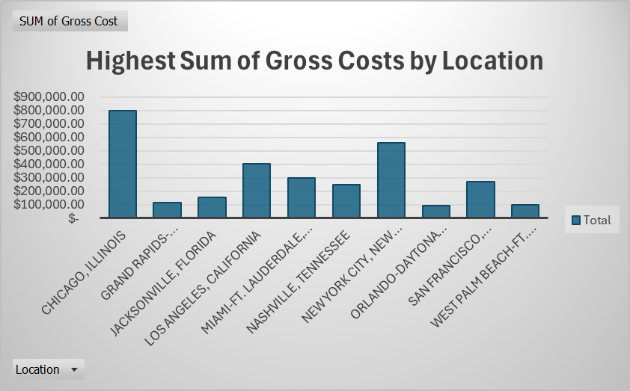
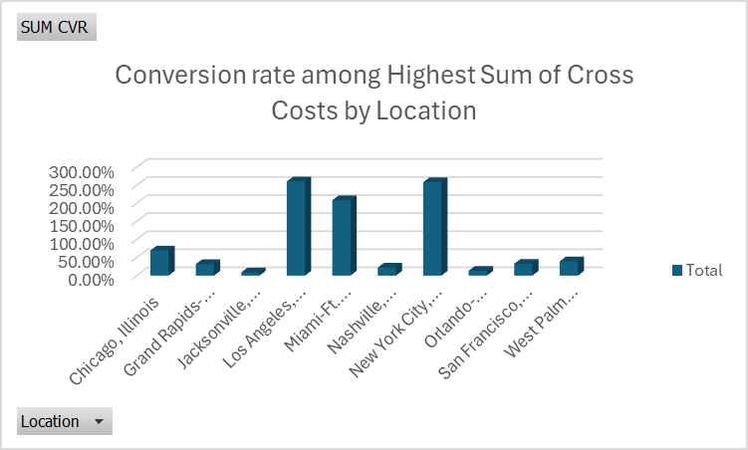
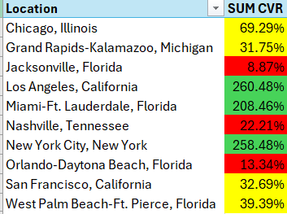
Cost-Effectiveness Across Locations

Slide 13
Inventory
Isael Corona- Inventory Analyst

Slide 14
Inventory Sources (Exchanges) : Performance Metrics
Metric | CPA | CPC | CPM | CVR
Exchange | GumGum | GumGum | Kargo | TripleLift
Value | $600.89 | $450.96 | $127.86 | .057%
Key Findings
The exchange GumGum did well with having a low CPC and CPA both being at $450.96 and $600.89 respectively
GumGum also came out in second place for CPM at $145.08
Overall GumGum would be a top inventory source that was successful

Slide 15
Inventory sources: Branding Metrics
Metric | CTR | Impressions | Visible Impressions | vCPM
Top Exchange | ShareThrough | Google Ad Manager | Google Ad Manager | PulsePoint
Value | 21.8% | 29964643 | 16114800 | $699.08
Google AD Manager ranked best in branding metrics by having good Impressions and Visible Impressions both being at 29964643 and 16114800 respectively
Google AD Manager also ranked 3rd in CVR at 2.4%
GumGum also ranked second in vCPM at $347.14

Slide 16
Ideal Publishers (Websites)

Slide 17
Top 5 Performances for Publishers
CTR
1.379% killingthyme.net
1.266% localmemphis.com
0.644% merriam-webster.com/dictionary
0.455% cbsnews.com
0.359% health.com
CVR
5.696% http://localmemphis.com/
0.738% miamiherald.com
0.695% mhvillage.com
0..681% downdetector.com
0.662% abc7chicago.com

Slide 18
Top 5 Performances for Publishers
CPM
$6.67 taboolanews.com
$16.08 cbssports.com
$20.04 a-z-animals.com
$20.90 mobileposse.com
$21.28 baseball-reference.com
CPC
$4.28 taboolanews.com
$19.99 http://mobileposse.com/
$24.62 http://fortune.com/
$31.30 drugs.com
$34.96 lotterypost.com

Slide 19
Top 5 Performances for Publishers
Viewable Impressions
6,717,348 mail.yahoo.com
3,484,549 yahoo.com
1,441,409 msn.com
1,361,938 ebay.com
442,979 streetinsider.com
Impressions
571,257 the-sun.com
361,640 nbcnews.com
237,993 cbsnews.com
179,723 taboolanews.com
145,113 nypost.com

Slide 20
Top 5 Performances for Publishers
CPA
$69.17 factable.com
$75.20 aol.com
$86.39 semana.com
$90.74 taboolanews.com
$110.12 zdnet.com
vCPM
$19.33 http://taboolanews.com/
$26.56 poshland.com
$37.3 http://a-z-animals.com/
$40.14 fortune.com
$50.92 http://historycollection.com/

Slide 21
Top inventory Publishers (WebSites) : Performance and Branding Metrics
Performance Metric | CPA | CPC | CPM | CVR
Publishers | factable.com | taboolanews.com | taboolanews.com | http://localmemphis.com/
Value | 69.17 | $4.28 | $6.67 | 5.70%
Branding Metric | CTR | Impressions | Visible Impressions | vCPM
Publishers | http://killingthyme.net/ | the-sun.com | mail.yahoo.com | http://taboolanews.com/
Value | 1.38% | 571,257 | 6,717,348 | $19.33
taboolanews.com performed the best overall with being the best performance metrics by being the best in half of the performance metrics
Yahoo performed the best by performing well in 2 of the branding metrics
taboolanews.com also did well in one of the branding metrics, so taboolanews.com did well overall

Slide 22
Creative Strategy
Emma Ramey- Creative Analyst

Slide 23



Creative Strategy
Small Banner 1 300 x 50
Small Banner 2 320 x 50
Identify which creative sizes are the highest and lowest performers
Medium Rectangle 300 x 250
Notes:
3. Banner – 468 x 60
The Banner has a wide format, similar to the Leaderboard ad, but smaller. It’s often placed above the navigation bar or between the main content. Despite the versatility factor, it does not offer better performance due to size constraints.
5. Inline Rectangle – 300 x 250
Also called the ‘Medium Rectangle”, this ad is very favorable among most online businesses. It performs well if placed in the sidebar and between organic content, which means it could potentially attract a wider audience.

Slide 24
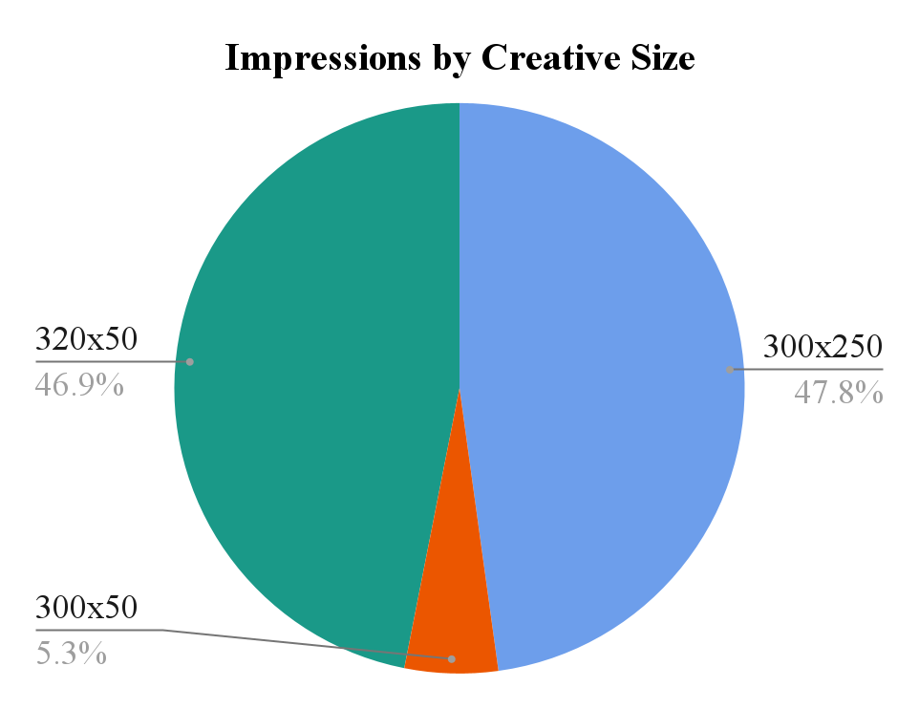
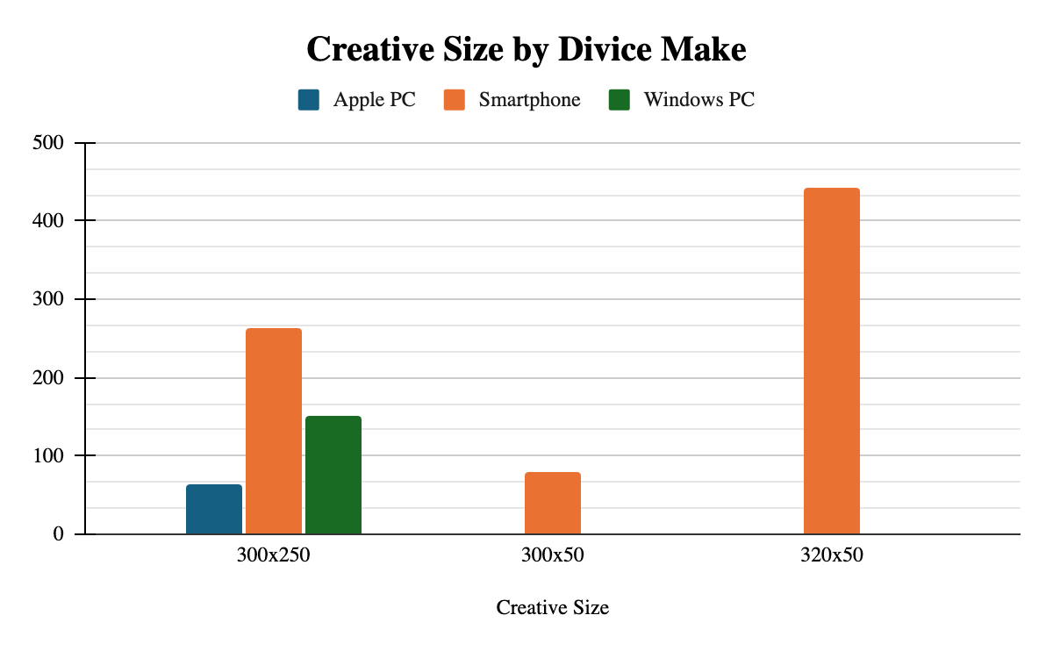
Majority of impressions split between 320x50 (40M + Impressions) and 300x250 (41M + Impressions)
79% of all ads viewed from a Smartphone.
300 x 250 viewed only on PC possibly due to ad size.
Notes:
Impressions help marketers understand how often their ads are being shown. While impressions alone don't measure user engagement or effectiveness, they provide a foundational metric for assessing an ad's visibility.

Slide 25
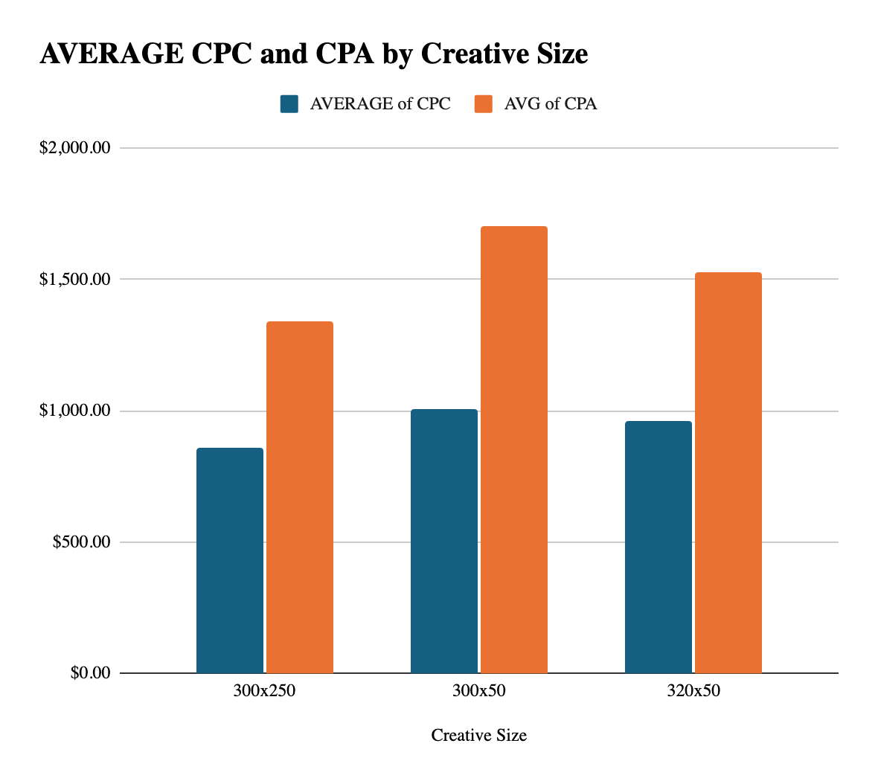
Performance Metrics
Creative Size | AVG of CPC | AVG of CPA | AVG of CVR
300x250 | $857.19 | $1,341.22 | 147%
300x50 | $1,003.79 | $1,705.14 | 215%
320x50 | $960.26 | $1,527.53 | 162%
300x250 has the best average Cost per Click and average Cost per Action, but the lowest average Conversion Rate.
300 x 50 highest average Conversion Rate, but worst average Cost per Click and Cost per Action. Keep in mind, 300x50 had significantly less impressions out of the 3 sizes.

Slide 26
Branding Metrics
Creative Size | AVG of CTR | AVG of Viewability | SUM of Viewable Impressions
300x250 | 0.029% | 54.60% | 19466323
300x50 | 0.026% | 53.62% | 2182036
320x50 | 0.032% | 54.68% | 20342415
Grand Total | 0.030% | 54.56% | 41990774
320x50 is the highest performer on average Click through Rate, Viewability, and sum of Viewable Impressions followed by 300x250 and the lowest performer, 300x50.

Slide 27
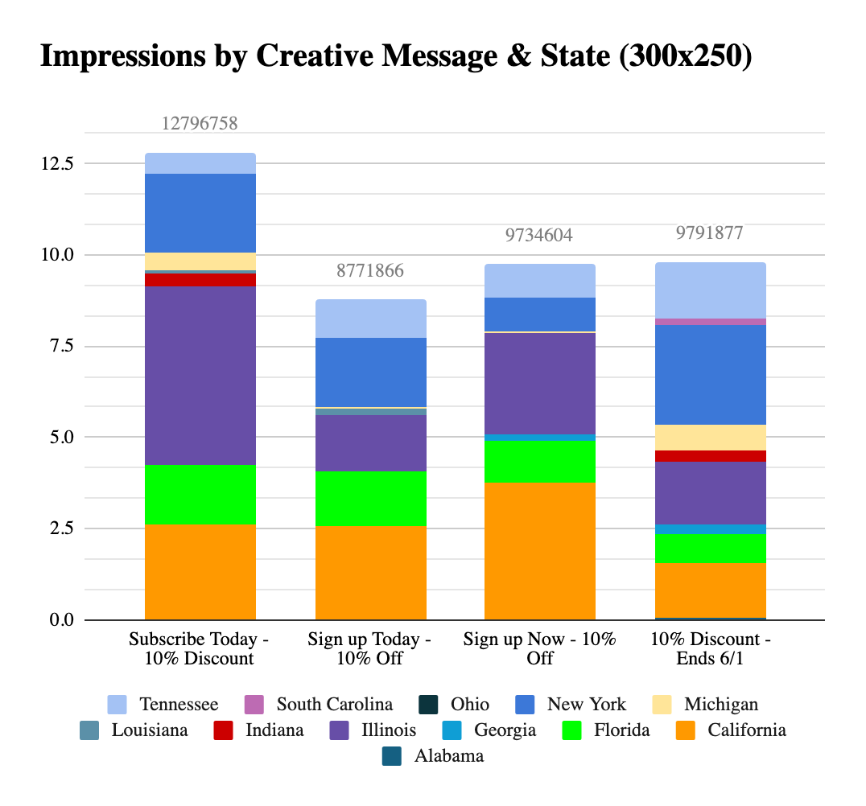
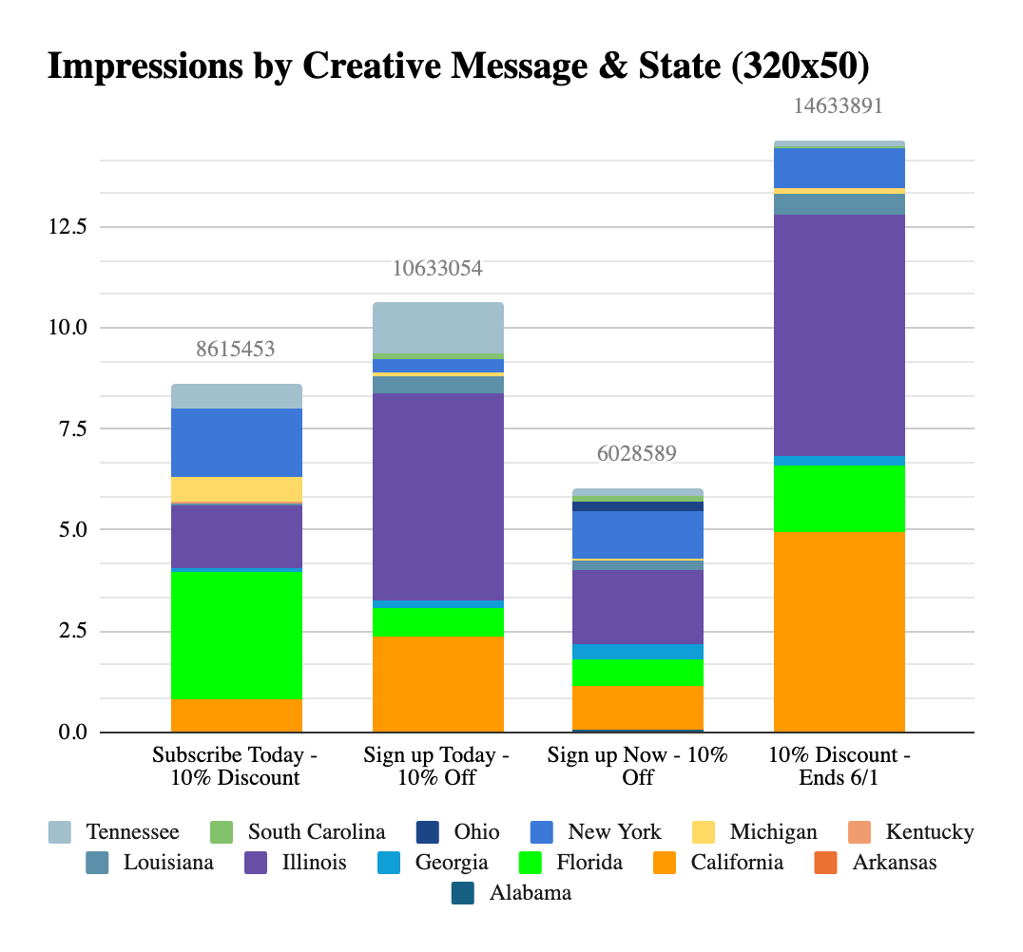
Location & Messaging
Best Performer: Subscribe Today - 10% Discount Top 3 Locations:Chicago, IL; Los Angeles, CA; New York, NY
Best Performer: 10% Discount - Ends 6/1 Top 3 Locations: Chicago, IL; San Francisco, CA; New York, NY

Slide 28
Audience Goals
Nicole Pastor- Audience Analyst

Slide 29
Audience Segment | CPC
Lotame > Home & Family > School & Education | $0.00
Lotame > News & Politics | $0.00
Lotame > Online Shoppers | $0.00
Lotame > Personal Finance > Stocks | $0.00
Lotame > Social Media > Online Dating | $0.00
Lotame > Style, Fashion & Clothing > Women's Clothing Shoppers | $0.00
Lotame > Style, Fashion & Clothing > Men's Clothing Shoppers | $0.00
Lotame > Technology > Computers & Software | $0.00
Lotame > Technology | $0.00
Lotame > Travel > Cruise Travel | $0.00
Notes:
Here is CPC, and By analyzing here, the lowest number’s indicate a good CPC. Here I noted some of many 0.00%’s so I choose randomly. We can see here that the sub - categories consist of school & education, online shoppers, and online dating.

Slide 30
Audience Segment | CVR
US » Reach » Sociodemographic » Education Level » High School Diploma | 160%
US Financial > Estimated Disposable Income (Financial) > $0 - $99,999 | 52.50%
Online Behavior>United States>The Changing Consumer>Video Conferencing | 50.00%
US > Reach > Propensity Models > Online > Lawn and Garden | 50.00%
US >Specialty Shopper Audience | 50.00%
OnAudience > Intent > Media > DVDs & Videos | 26.47%
US Interest > Reading > General | 23.26%
Lotame > Social Media > Online Dating | 20.75%
Mobile - US > Device Ownership > Tablets > iOS (Apple) > yes | 14.29%
Media and Entertainment > Gaming | 3.11%
Notes:
By analyzing our data, we identified the top 10 performing audiences. For instance, ‘Education Level' is our top performer with a CVR of 160%. Other high performers include 'Income' and Video Conferencing”

Slide 31
Performance Metrics
Audience Segment | CPA (Cost Per Acquisition)
US » Demographic » Family » Households with 2 Adults | $18.47
US » Brand Propensities » Restaurants and Dining » Seamless Buyer Propensity | $22.04
Travel and Tourism » Interest (Affinity) » Destinations » Africa | $33.93
Real Estate » Lot Size » Cozy Outdoor Living Space (Less than an Acre) | $45.49
Online Behavior>United States>Autos and Vehicles Â» Brands>Mazda | $45.76
Online Behavior>United States>Finance > Credit and Lending>Credit and Lending | $52.20
OnAudience > Interest > Shopping > Online Shoppers | $62.22
Media and Entertainment > News and Current Events | $62.38
Mobile - US > Sports > Motor Sports > NASCAR | $63.49
US Interest > Home > Home Improvement > Home Improvement Grouping | $64.22
Notes:
HI everyone I am the audience Analyst.
here are the top 10 highest performing audiences for CPA. 'Households with 2 Adults' is our top performer with a CPA of just $18.47. Other high performers include 'Seamless Buyer Propensity' and 'Destinations - Africa,' which offer cost-efficient conversions."

Slide 32
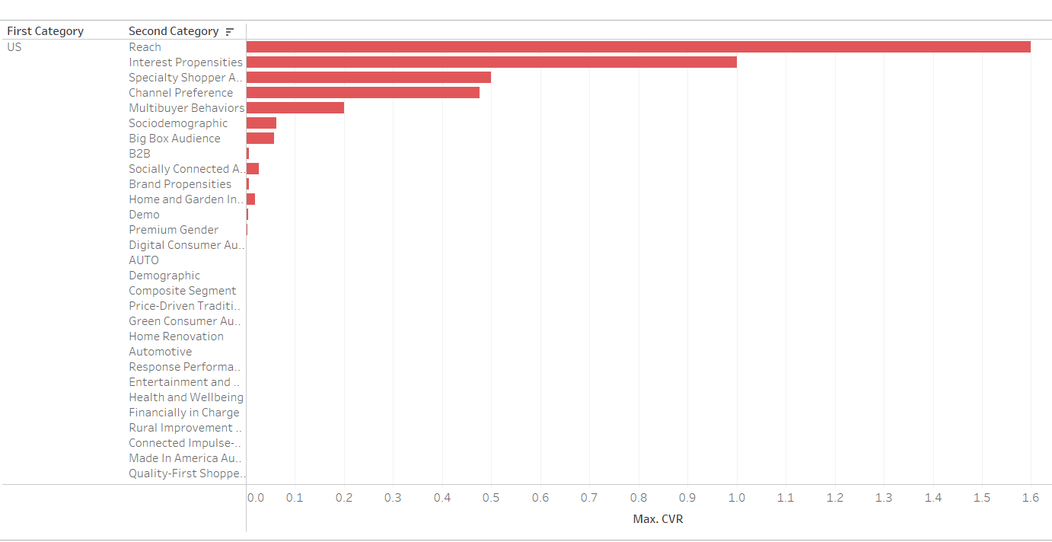
CVR( Conversion Rate)
US, Reach, Socio Demographic » Education Level » High School Diploma has the highest CVR amongst the others
Notes:
% of how highly someone is to buy or do something
Here is a graph showing the CVR. More so the highest performing audience for CVR.
US REACH HAS 160%

Slide 33
Branding Metrics
Audience | CTR
On Audience > Interest > Arts & Entertainment > Music | 1.38%
OnAudience > Intent > Media > Music | 1.27%
Online Behavior > Sports > Individual Sports > Golf | 0.82%
OnAudience > Demography | 0.64%
Lotame > Personal Finance > Online Banking | 0.53%
Online Behavior > Autos and Vehicles > Vehicle Ownership | 0.43%
Online Behavior > People and Society > Religion and Belief | 0.42%
Mobile - US > Automotive > Vehicle Ownership | 0.36%
Online Behavior > Home and Garden > Home Improvement | 0.32%
Online Behavior > Autos and Vehicles > Car Enthusiasts | 0.26%
Audience | AVG of Viewable Impressions
Online Behavior | 28993663
US | 7135430
OnAudience | 1099258
Trending patterns
On Audience ,US Travel, and US have the highest average of CTR
Online Behavior, US, & On Audience have the highest average of Viewable Impressions

Slide 34
Audience | Viewable Impressions
Online Behavior > Finance > Credit Card | 2,338,732
Online Behavior > Autos and Vehicles > Car Enthusiasts | 2,013,324
Online Behavior > The Changing Consumer > Digital Natives | 1,155,869
Online Behavior > Life Event > College Graduates | 1,151,776
Online Behavior > Autos and Vehicles > Luxury Vehicle Enthusiasts | 1,135,085
Online Behavior > Sports > Team Sports | 981,461
Online Behavior > Travel > Specialty Travel | 940,296
Online Behavior > Finance > Account Owners | 881,525
Online Behavior > Finance > Financial Planning | 737,990
Online Behavior > The Changing Consumer > Smart Device Users | 699,834
Trending patterns
Online Behavior dominates the Viewable Impressions, with the highest coming in with 2,338,732 viewable impressions.
Notes:
From this information, the subcategories that kept showing up from the top 10 were Education, Family, Education Level, Arts, Sports, College Graduates and Finance. And from this we can gather that the audiences seemed to appear as College Students, near the 20s - 30’s. As these topics are most relevant to them.

Slide 35
Conclusion

Slide 36
Recommendations
Only Banner ad sizes 320x50 and 300x350 (eliminate 300x 50 — too similar to 320x50); target smartphones; Messaging: include the word “Discount”; Location: Chicago, IL (emerged as a costly market, but a leading DMA location across measurable impressions)and other major metropolitan areas.
The source that ranks the best Overall Is GumGum as it is has been the best for some metrics or is in the top 3 of that metric. Another good source is google Ad Manager because it did well in the branding metrics and CVR.
Publishers that do we’d recommend are Taboola.com, MSN.com, cbsnews.com and Mail.Yahoo.com as they are within the top 5 of all metrics
For audiences, Online Behavior, On Audiences, and US were in the top audiences. More specifically Education, Finance and Family were shown more often in the charts, so aiming towards a 20s to 30s demographic is important.
Notes:
For Instance, from Online Behavior to Autos and Vehicles to Car Enthusiasts had High viewable impressions and decent CTR.

Slide 37
Thank you!
Questions?

